Slide 1


Data driving change in healthcare for…
Dr. Michelle Heys 1st Dec 2021
Associate professor in population and community child health, UCL Institute of child health & consultant paediatrican, EAST LONDON FOUNDATION TRUST

Slide 2
overview
Defining data
What can data do for you?
Audit/QI/ health service evaluation and research
Key messages around data driving change
Examples of nationally held data and discussion of strengths and weaknesses
Challenge to you

Slide 3
Learning outcome
Recognise the power of data in influencing change
children and young people’s health
Use at least one example of freely available routine data to explore a health outcome in your area.

Slide 4
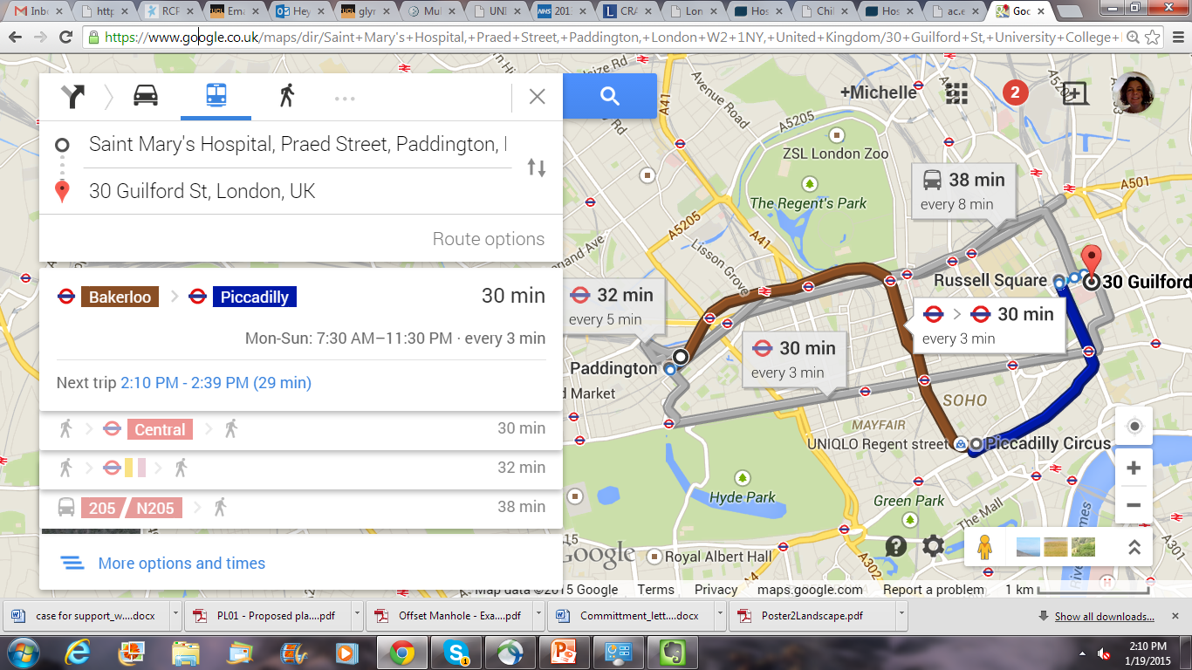
Human driven process

Slide 5
Types of data
Qualitative
Quantitative
Clinical
Research
Routine administrative data
Structured
Semi-structured
Unstructured
Routine and non-routine data

Slide 6
Routine data
(administrative data)
“Data that are routinely collected and recorded in an ongoing systematic way, often for administrative or statutory purpose and without any specific research question in mind at the time of collection”
Hansell A, Aylin P.Use of health data in health impact assessment.
Impact Assessment and Project Appraisal 2003; 21(1):57-64

Slide 7
Where does routine health data come from?
Mortality
Births
Cancer
Health Survey for England
Notification of infectious diseases
Terminations
Congenital anomalies
Hospital episodes
Community systems
GP data e.g. Quality and Outcomes Framework
Prescription data
Electronic health record
Road Traffic Accidents

Slide 8
Routine National datasets
ChiMat
HES online (aggregated data)
Atlas of variation
London Health Observatory
General Practice Profiles
Health needs assessments
Department of education – eg. LAC data returns
Joint strategic needs assessments
The Community Services Data Set (CSDS)
  Personal and demographic
  Social and personal circumstances
  Breastfeeding and nutrition
  Care event and screening activity
  Diagnoses, including long term conditions and childhood disabilities
  Scored assessments

Slide 9
https://fingertips.phe.org.uk/profile/child-health-profiles

Slide 10
strengths and weaknesses of these databases (routine data)
Strengths
Freely available
Comparative
Cheap
Already collected
Standardised ?
Comprehensive
Wide range
Available for past years
Experience in use
Weaknesses
Aggregated data
Variable quality
Variable validity
Coding changes
Dodgy/ messy/ complex
Data silos
Lack of standardisation
Limited
May not answer your q
Notes:
May not answer the question
Incomplete ascertainment
Variable quality
Validity may be variable
Disease labelling may vary over time or between geographical areas
Coding changes may create artefactual increases or decreases in rates
Need careful interpretation

Slide 11

What can data do for you?
Notes:
How do you think we use data?

Slide 12
Data are not your master
Are neither good nor bad
It’s what YOU do with it that matters
Data alone are only as good as people's ability to use it
Data driven means that data need to be consumable and contextualised to encourage action that will result in behaviour change over time

Slide 13
How can data influence change?
Human led process
=
Meaning/
information
Data
+
=
knowledge
+
+
change
Structure
and/ or context
Interpretation
of information
action
Change in what?
  Behaviour?
  Change in whom?
  Whose? Patients? Providers?
  Health system?
  Why??
Data alone cannot drive change
Notes:
Data are words, numbers, dates, images, sounds etc without context.
Data items need to be part of a structure, such as a sentence, in order to give them meaning.

Slide 14
What can Data do for you?
Clinical data
  Individual
  Group
Configuration of services
Service development
Business case
Job descriptions
Commissioning
Negotiating service specifications
Integrating services
Advocating
Evidence
Training
politics
Highlight inequity
Notes:
Data is just information
As clinicians we are used to using data everyday in our clinical assessment.

Slide 15
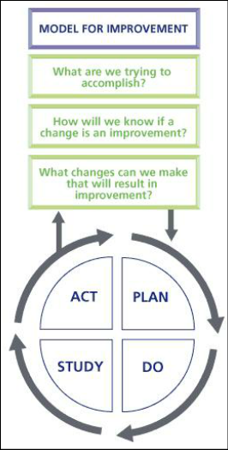

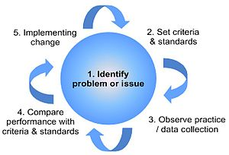
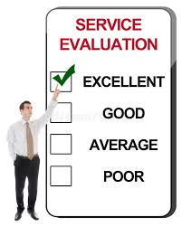
Audit? SERVICE EVALUATION?
QI? Research?
RESEARCH
AUDIT
SERVICE EVALUATION
QI
Notes:
Quality improvement (QI) aims to improve the patient experience.
Whilst audit is often more clinically orientated, QI can focus on more holistic issues, e.g. the availability of hot drinks in A&E. QI can be done using the "Plan Do Study Act" (PDSA) framework. PDSA cycles are iterative and
"a quality improvement process that seeks to improve patient care and outcomes through systematic review of care against explicit criteria and the implementation of change". have short time spans allowing improvement to be incorporated quickly.

Slide 16
Audit? SERVICE EVALUATION?
QI? Research?
RESEARCH
AUDIT
What is the best evidence/ practice?
Creates new knowledge
May involve doing something different to the patient
Results are generalisable
Gold standard as comparative
Are we following best practice?
Never involves doing anything different to the patient
SERVICE EVALUATION
How are we doing?
What standard are we reaching?
QI
How can we do this better?
Notes:
Quality improvement (QI) aims to improve the patient experience.
Whilst audit is often more clinically orientated, QI can focus on more holistic issues, e.g. the availability of hot drinks in A&E. QI can be done using the "Plan Do Study Act" (PDSA) framework. PDSA cycles are iterative and
"a quality improvement process that seeks to improve patient care and outcomes through systematic review of care against explicit criteria and the implementation of change". have short time spans allowing improvement to be incorporated quickly.

Slide 17
Audit? SERVICE EVALUATION?
QI? Research?
RESEARCH
AUDIT
SERVICE EVALUATION
QI
Improve efficiency and quality of service
To generate generalizable new knowledge
To understand how we are doing?
Improve compliance & implementation
Notes:
Quality improvement (QI) aims to improve the patient experience.
Whilst audit is often more clinically orientated, QI can focus on more holistic issues, e.g. the availability of hot drinks in A&E. QI can be done using the "Plan Do Study Act" (PDSA) framework. PDSA cycles are iterative and
"a quality improvement process that seeks to improve patient care and outcomes through systematic review of care against explicit criteria and the implementation of change". have short time spans allowing improvement to be incorporated quickly.
service evaluation is a way to define or measure current practice within a service
A service evaluation is a way to define or measure current practice within a service. The results of the service evaluation help towards producing internal recommendations for improvements that are not intended to be generalised beyond the service area. Therefore a service evaluation is designed to answer the question "what standard does this service achieve?".
Ultimately all have same aim
Improve health and wellbeing of children and young people
RESEARCH
Generalisable
New knowledge
Needs ethics approval

Slide 18
Key messages
Human driven process
Data alone cannot drive change
Data driving change in health and health care delivery is not new

Slide 19
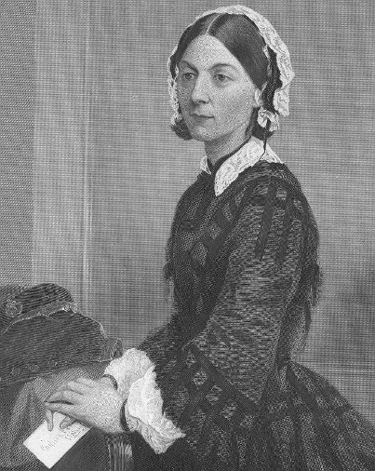
Florence Nightingale
Data driving change is not new
a pioneering and passionate statistician
Notes:
But the "lady with the lamp" was also a pioneering and passionate statistician. She understood the influential role of statistics and used them to support her convictions.
Died 1910

Slide 20
Florence Nightingale
Uniform hospital statistics would:
  “Enable us to ascertain the relative mortality of different hospitals as well as of different diseases and injuries at the same and at different ages, the relative frequency of different diseases and injuries among the classes which enter hospitals in different countries, and in different districts of the same country”
  Nightingale 1863

Slide 21
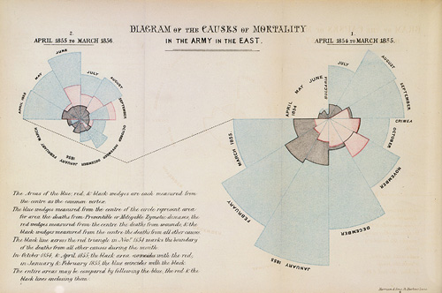
Polar area diagram
causes of mortality
blue = contagious diseases
red = wounds
black = deaths from all other causes.
Data visualisation is really important

Slide 22
Mortality from open procedures in children aged under one year for 11 centres in three epochs; data derived from Hospital Episode Statistics (HES)
Acknowledgement: Sonia Saxina
Notes:
Heart operations at the BRI
“Inadequate care for one third of children”

Slide 23
Final report of the Bristol Inquiry
“Bristol was awash with data. There was enough information from the late 1980s onwards to cause questions about mortality rates to be raised both in Bristol and elsewhere had the mindset to do so existed.”

Slide 24
Bristol (Kennedy) Inquiry Report Data were available all the time
“From the start of the 1990s a national database existed at the Department of Health (the Hospital Episode Statistics database) which among other things held information about deaths in hospital. It was not recognised as a valuable tool for analysing the performance of hospitals. It is now, belatedly.”
We can be awash with data, but just don’t know how to use it… although…
Notes:
Are community level measures for CYP on the map?
How much do we know about the CYP that we see?
Are community paediatricians in the room?

Slide 25

you can’t manage what you don’t measure
“Variations in Care: An analysis of cerebral palsy provision”
National enquiry to all LA/CCGs
  Majority (96%) LA/CCGs unable to say how many CYP with CP
  Limited info on training (6% able to state HV training in CP)
Little information on service provision
  6.7% had details of pathway
Integration of services for CYP with CP poor
  27% provided therapy services “under one roof” (more likely London)
Awareness of CP in medical generalists poor
Variation in provision nationally
No CCG able to provide estimates of costs

Slide 26
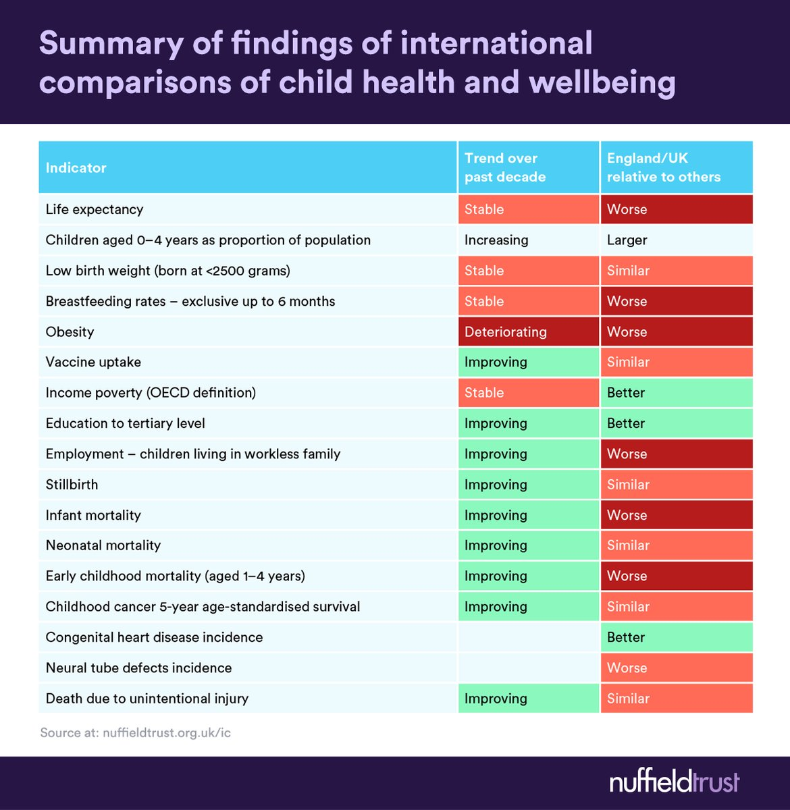
value of comparisons
- inequity and variation
Where are the data around community paediatrics?

Slide 27
Atlas of variation

Slide 28
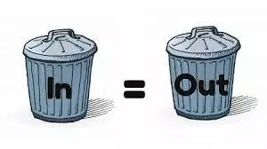
data quality matters

Slide 29
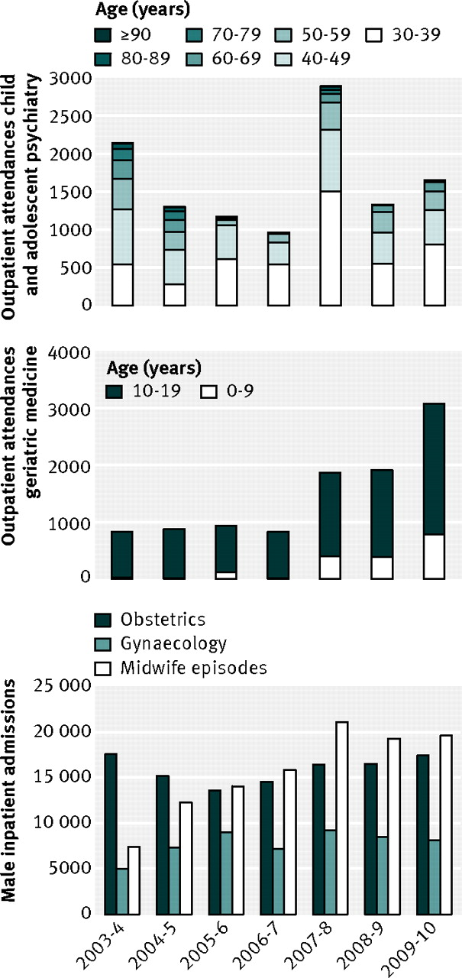

The importance of knowing context of hospital episode statistics when reconfiguring the NHS
Outpatient attendances to child and adolescent psychiatry by those aged from 30 to 90 and over.
Outpatient attendances to geriatric medicine by those aged 0-19 years.
Male inpatient admissions to obstetrics and gynaecology, as well as midwife episodes
Brennan L et al. BMJ 2012;344:bmj.e2432
©2012 by British Medical Journal Publishing Group
Notes:
Lauren Brenan, Mando Bob at Imperial
Reviewed HES data from 2003-2010
Indeed, the number of adults attending outpatient paediatric services since 2003 has increased steadily, with a steep increase, to nearly 20 000,
The number of 0-19 year olds attending outpatient geriatric medicine services has increased steadily, with over 3000 attendances in 2009-10
However, the number of inpatient admissions to geriatric medicine and old age psychiatry by 0–14 year olds has remained fairly constant.3

Slide 30
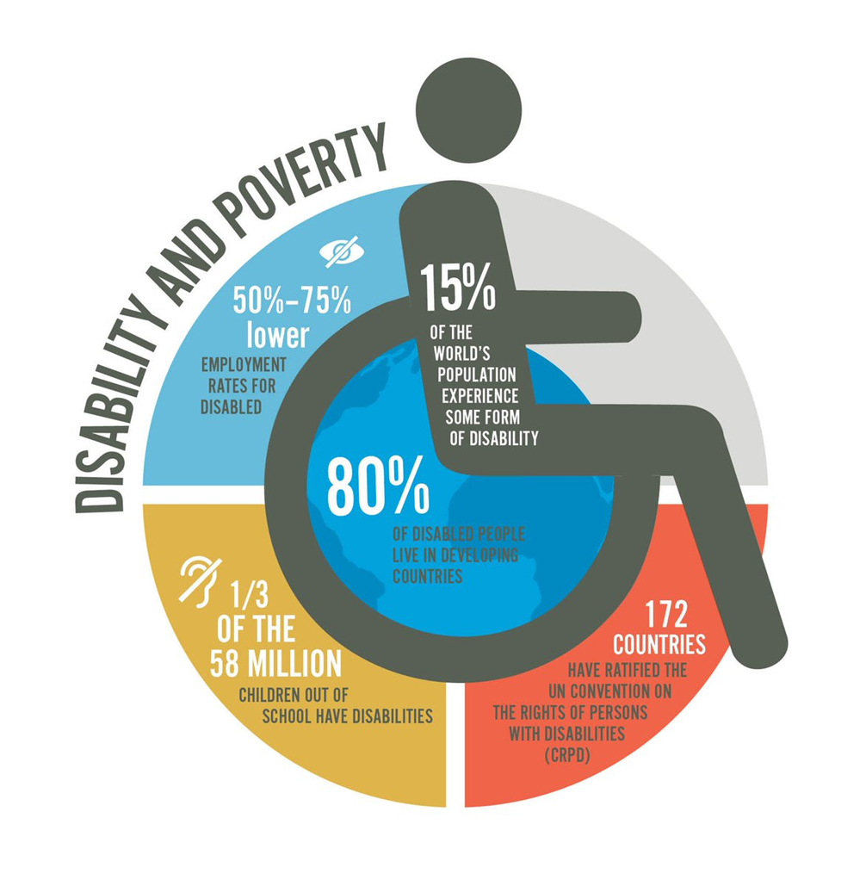
Data visualisation

Slide 31
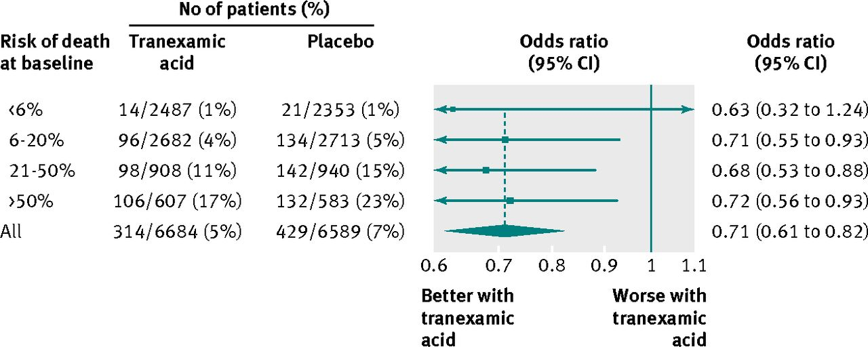

Fig 2 Death from bleeding in patients with traumatic bleeding according to treatment with tranexamic acid (P=0.98 for heterogeneity).
Tranexamic acid associated with 0.7 reduced odds of death with 96% confidence interval of 0.61 to 0.82
Roberts I et al. BMJ 2012;345:bmj.e5839
©2012 by British Medical Journal Publishing Group
Notes:
Fig 2 Death from bleeding in patients with traumatic bleeding according to treatment with tranexamic acid (P=0.98 for heterogeneity)‏
Invented in the 70s in Japan
Used in women to help with heavy periods
Tested in trauma victims
CRASH-2 trial

Slide 32

Notes:
The majority of deaths in active combat are a result of trauma. If all trauma patients were treated within 3 hours with transexamic acid

Slide 33
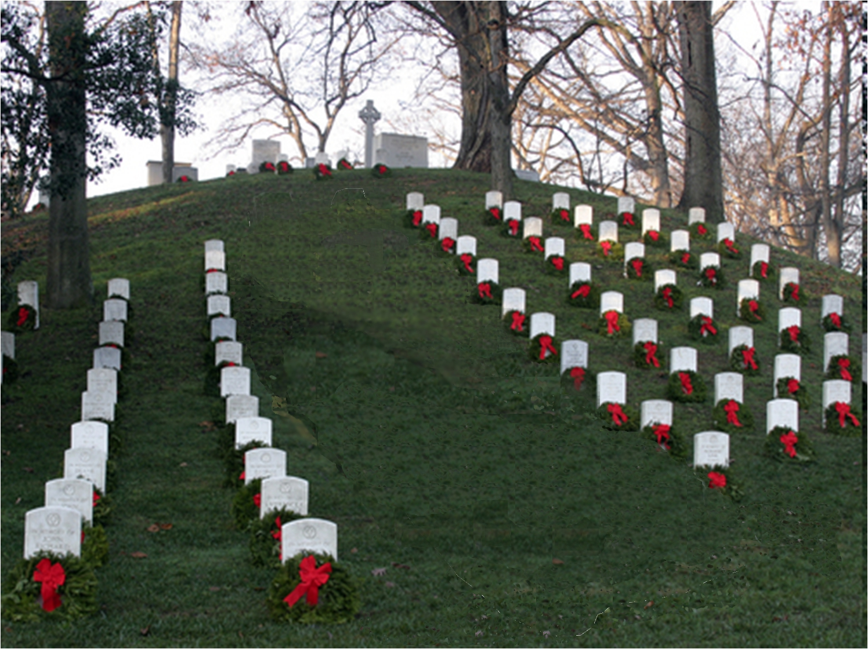
Notes:
A third of deaths would be avoided.

Slide 34
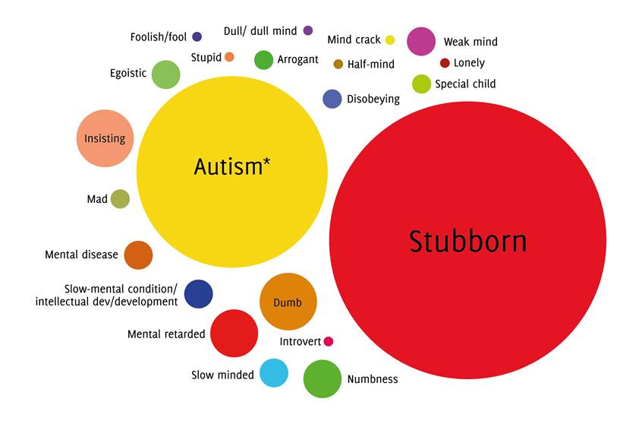
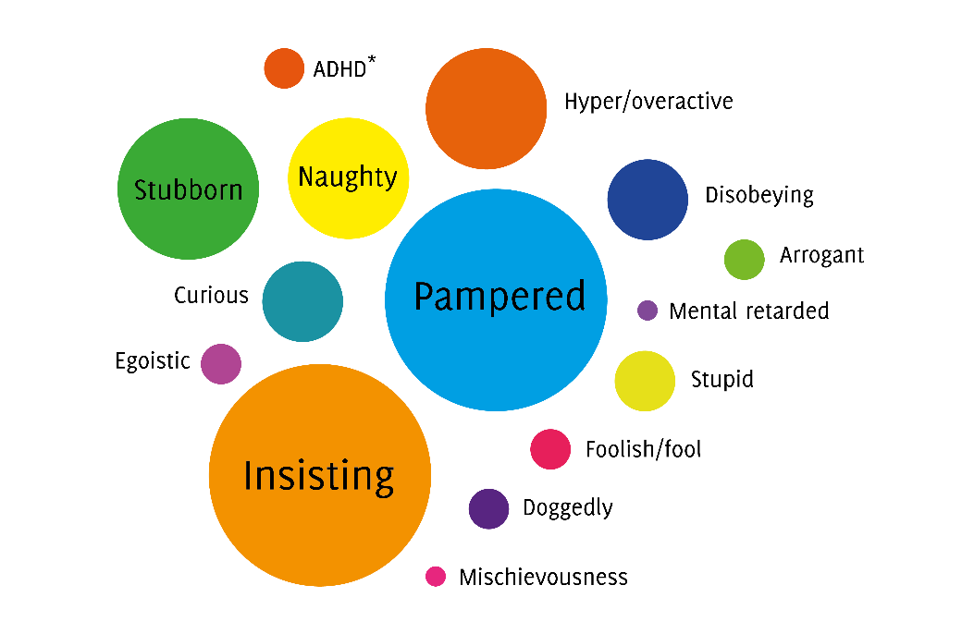
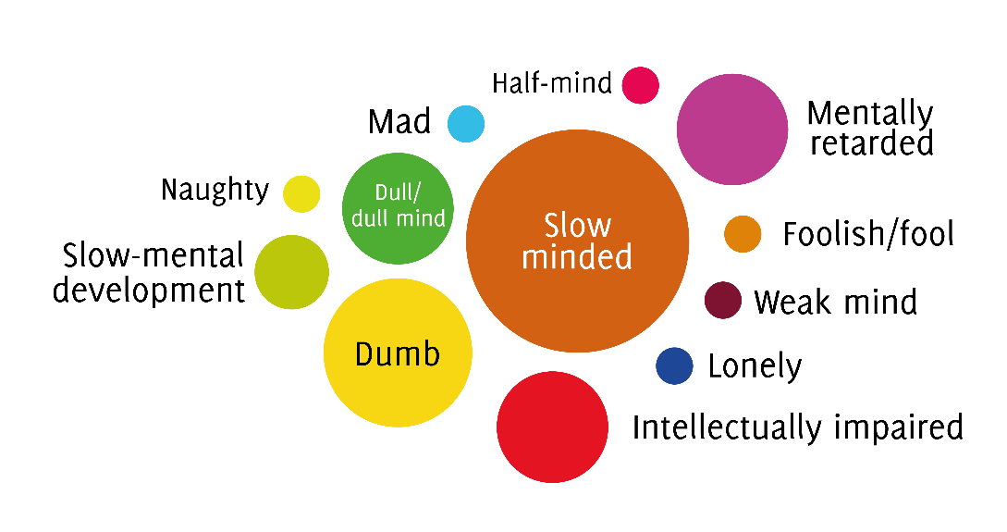
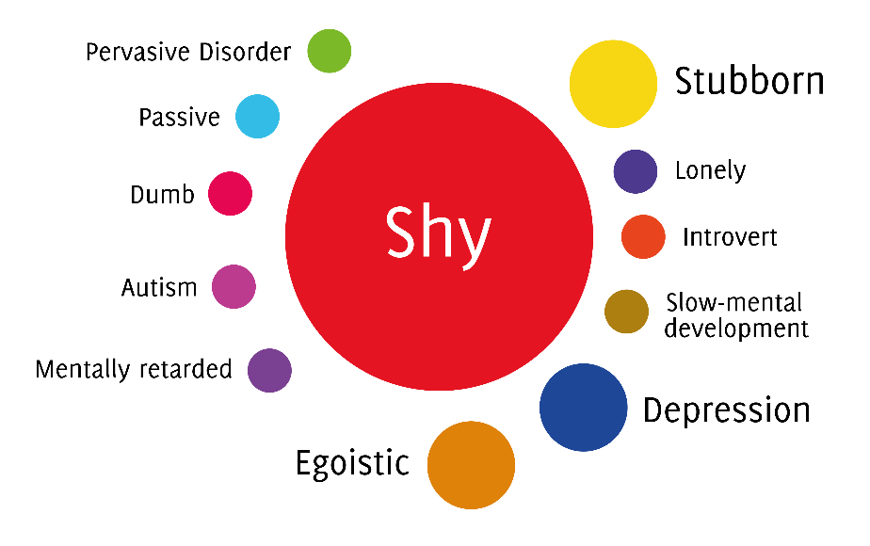
Autistic boy
Boy with ADHD
Girl with GDD
Autistic girl

Slide 35
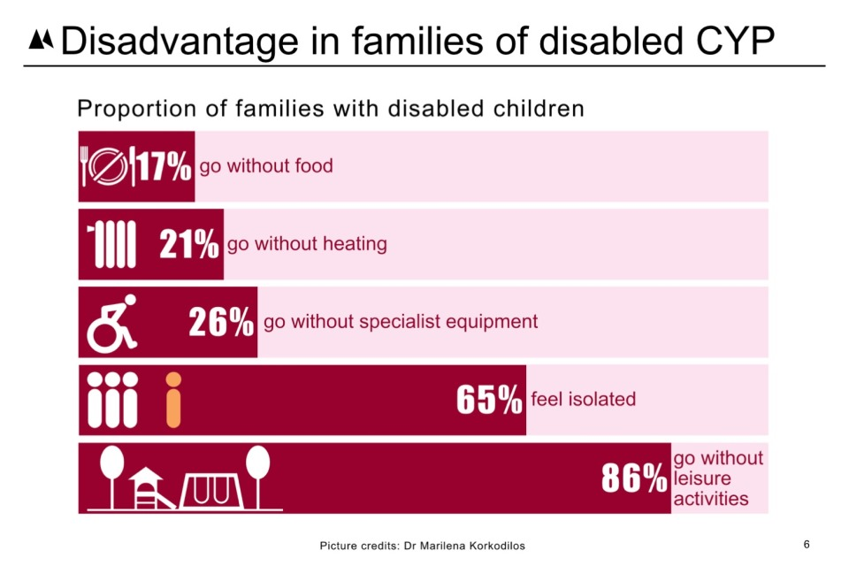

Slide 36
Data can be a powerful driver for change for training
How do we train our doctors who are carrying out IHA? And those conducting annual reviews?
DoE: Children looked after in England (including adoption and care leavers) year ending 31 March 2015

Slide 37
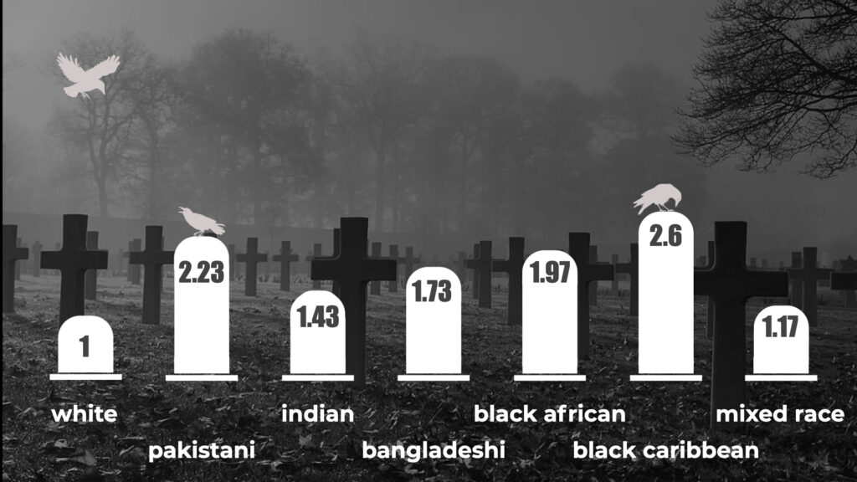
HOW DOES ETHNICITY AFFECT CHILD HEALTH OUTCOMES?
Zeshan Qureshi, Alexandra Richards, Ian Sinha, Oluwakemi Lokulo-Sodipe, Anna Rose, Written on 25/11/2021
Last updated 26/11/2021
https://dontforgetthebubbles.com/how-does-ethnicity-affect-child-health-outcomes/
Infant mortality rate by ethnicity (2019)

Slide 38
And for workforce planning
BACCH workforce planning tool
22% of paediatric consultants work in CCH
60% of SAS doctors work in CCH

Slide 39

Data are only part of the story
stories, backed up by meaningful, well described data make an impact – particularly politicians and commissioners

Slide 40
layer 1 (anecdote)
Registrar in hand over
  “I had 3 patients admitted in status epilepticus last night”
  “2 were long standing patients with complex neurodisability and epilepsy”
  One of them hadn’t had their meds increased according to their weight. The other had run out of buccal midazolam and wasn’t sure who to call to get hold of some.

Slide 41
Layer 2 – local evidence, routine data
The child public health registrar did a review of all frequent A&E attenders
  Children presenting to A&E with seizures had 3 times greater odds of presenting to A&E on 4 or more occasions in the year than children with other presentations
  Commonest single diagnostic category of frequent attenders
  Small group of children using A&E a lot
  Known to have a diagnosis of epilepsy, seemingly poorly controlled
Why? What can we do about it?
  No unified epilepsy service
  No community epilepsy nurse

Slide 42
Layer 3 - patient voice/ story
Letter from parent
  18 year old boy with severe cerebral palsy, home ventilation, poorly controlled seizures
  Admitted to A&E in status via 999
  Concurrent viral illness, febrile
  Admitted via adult team. No transfer notes. No management plan.
  Full septic work up attempted
  Pediatric registrar called when they couldn’t get iv access
  Seizures still uncontrolled
  Access obtained, seizures controlled
  No bed available in adults. Paediatric ward refused bed placement.
  Majors full.
  He moved to the corridor. Where he remained until paeds cubicle available (consultant led admission)

Slide 43
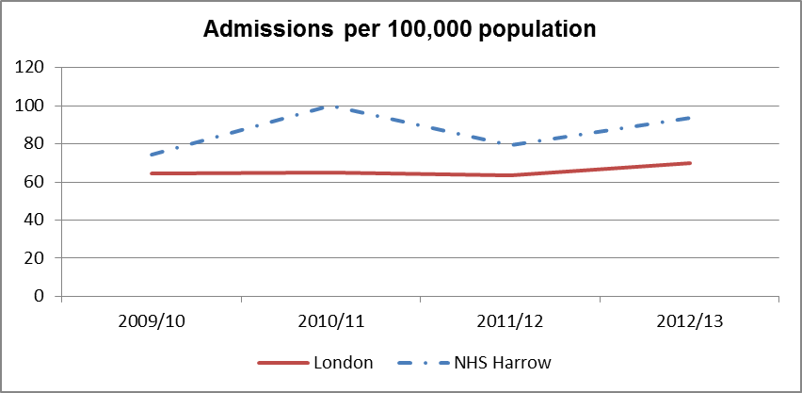
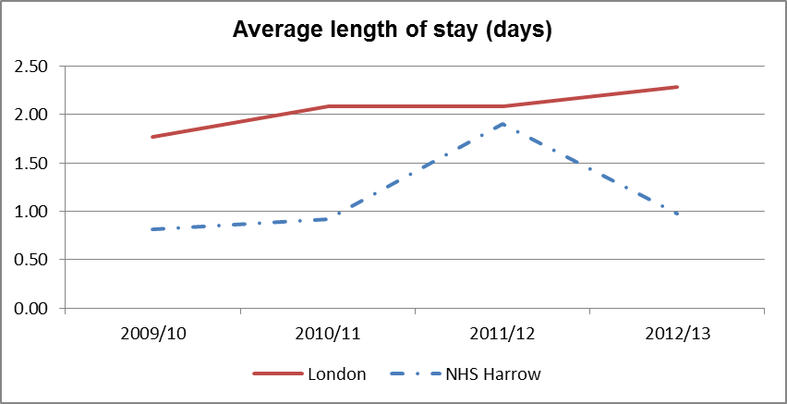
Layer: evidence – national comparative data
http://atlas.chimat.org.uk/IAS/dmit

Slide 45
Integration of sources and impact
Grand round/ CCG meeting
  Registrar does case presentation
  Parent comes to talk
  Child public health registrar presents frequent A&E attendance data
  Chimat data presented on national variation in epilepsy services
  Finance officer presents cost implications
Business case
  Community epilepsy nurse
  Community nurse appointed matron of ward
  ED attendance data methods taught to community nursing team

Slide 46
Quality Improvement & data
QI quant and descriptive data tools:
  Process maps
  Cause and effect diagrams (fish bones)
  Check sheets
  Histograms
  Scatter diagrams
  Pareto charts
  Control charts
PPI
  Qualitative data

Slide 47
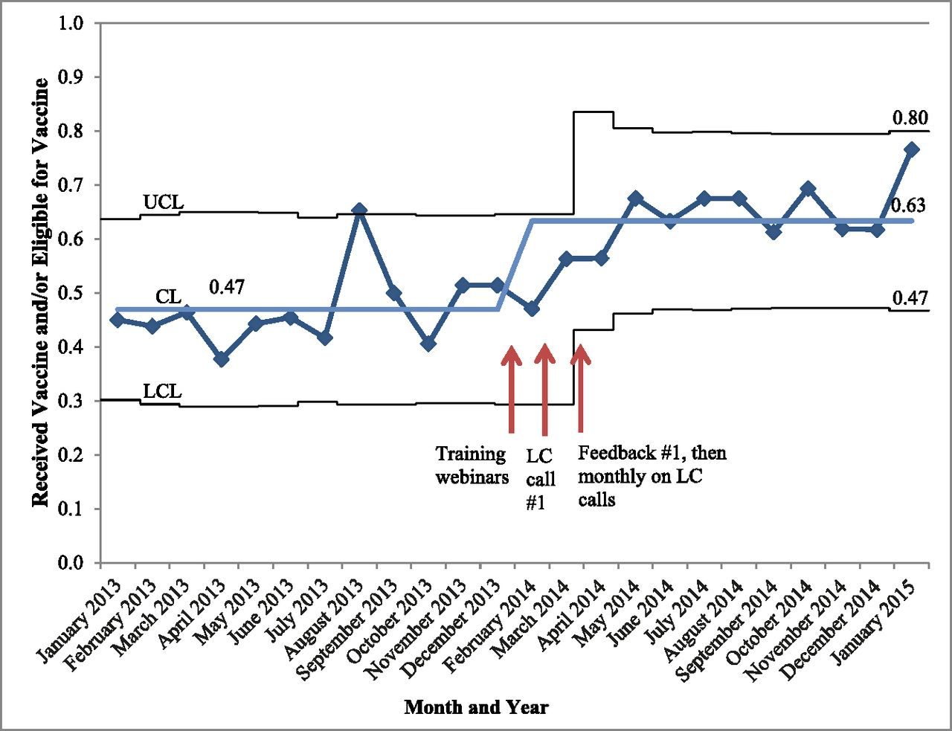
control chart
The impact of QI training + bundled intervention in HPV vaccination
Notes:
the impact of quality improvement (QI) training plus a bundled practice-based intervention (
provider prompts
plus communication skills training
plus performance feedback - monthly
on improving HPV vaccinations in pediatric resident continuity clinics.
CL: control limit
UCL – upper
LCL – lower
Pediatrics
March 2018
From the American Academy of Pediatrics
Quality Report
Provider Communication, Prompts, and Feedback to Improve HPV Vaccination Rates in Resident Clinics
Cynthia M. Rand, Stanley J. Schaffer, Nui Dhepyasuwan, Aaron Blumkin, Christina Albertin, Janet R. Serwint, Paul M. Darden, Sharon G. Humiston, Keith J. Mann, William Stratbucker, Peter G. Szilagyi

Slide 48
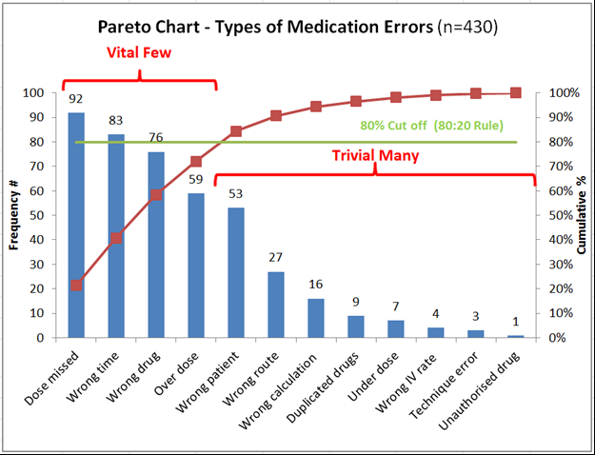
Pareto chart
Notes:
The Pareto principle (also known as the 80/20 rule, the law of the vital few, or the principle of factor sparsity) states that, for many events, roughly 80% of the effects come from 20% of the causes
Relative importance of problems

Slide 49
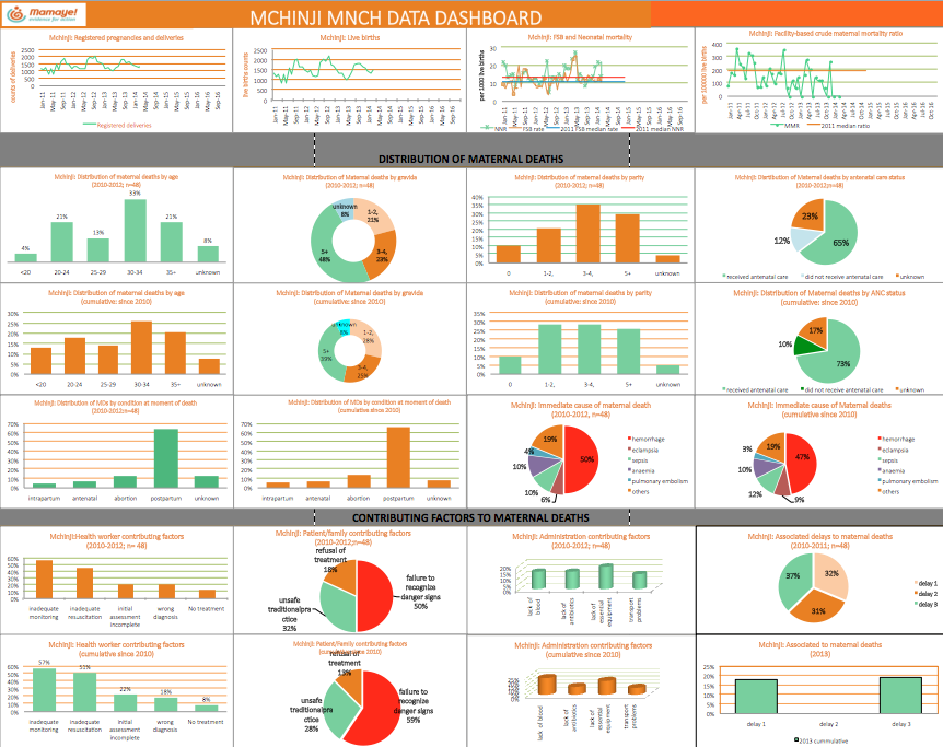
Data dashboards

Slide 50



Digital Data Capture

Slide 51
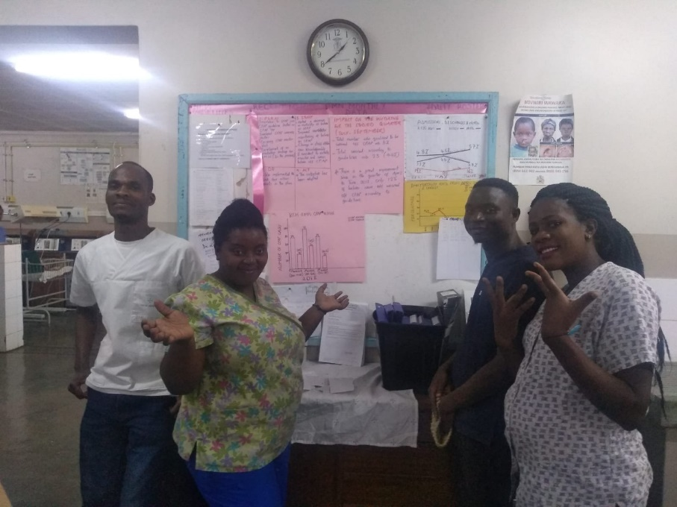
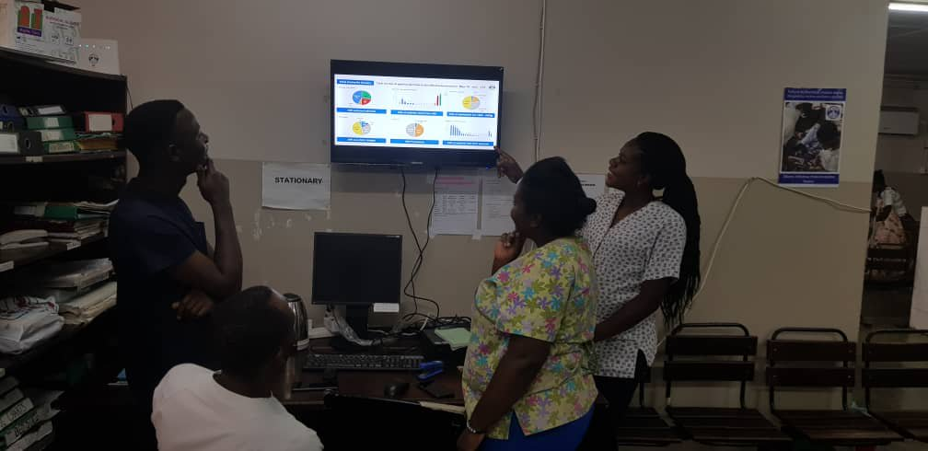


Slide 52

Rules
Information governance
GRDP
Research ethics
Common sense
Do no harm

Slide 53
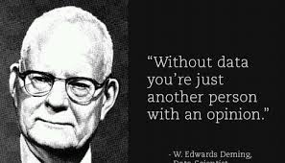
Notes:
Well-functioning health systems need to utilize data at all levels, from the provider, to local and national-level decision makers, in order to make evidence-based and needed adjustments to improve the quality of care provided.

Slide 54
Thank-you
@m_heys
m.heys@ucl.ac.uk
Michelle.heys@nhs.net

Slide 55
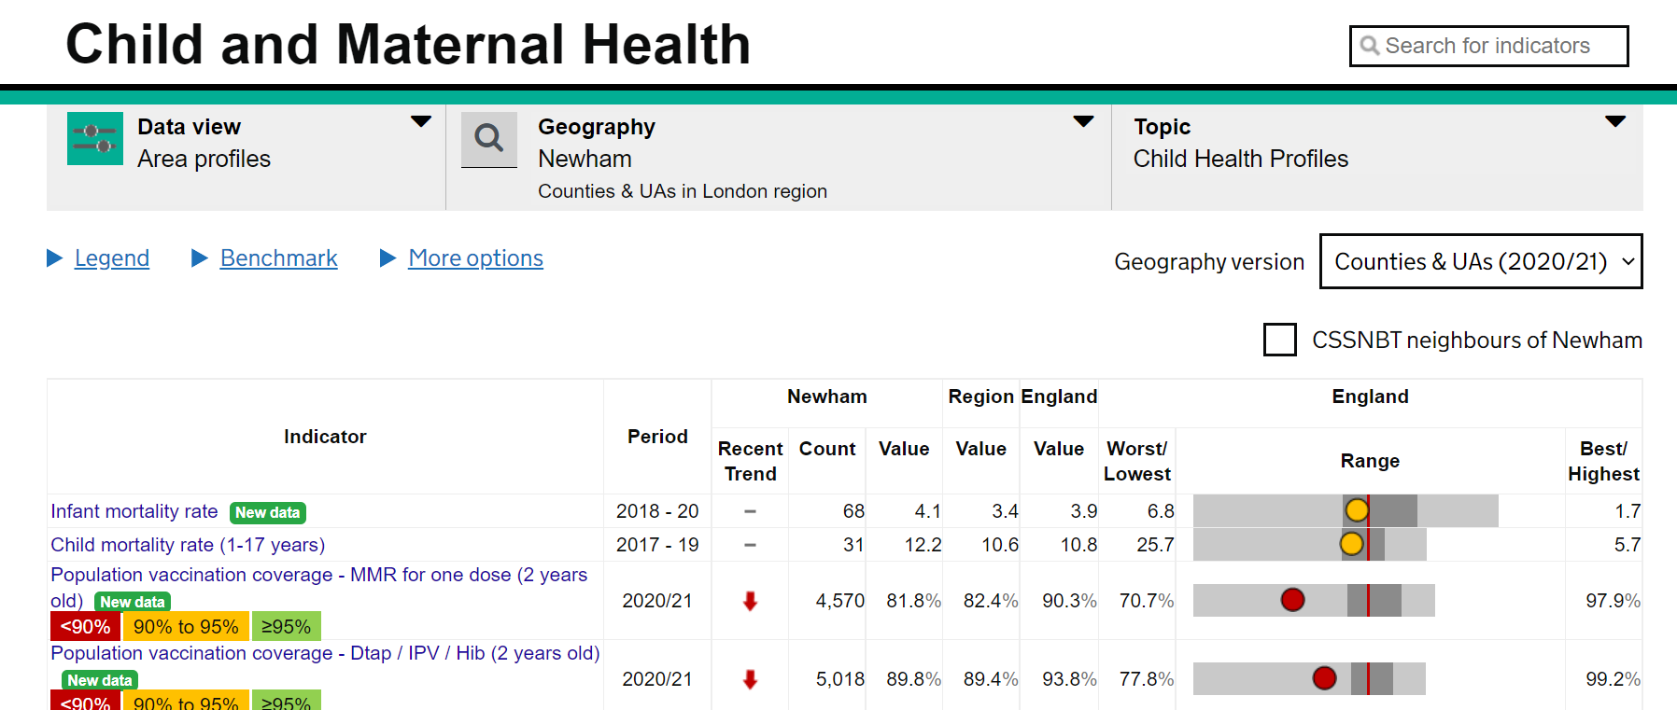
Chimat
PHE England fingertips

Slide 56



Slide 57
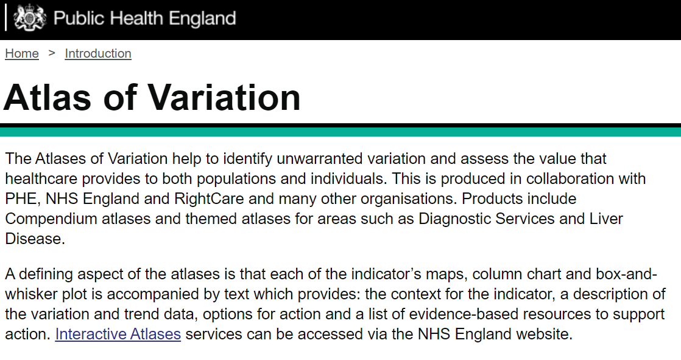

Slide 58
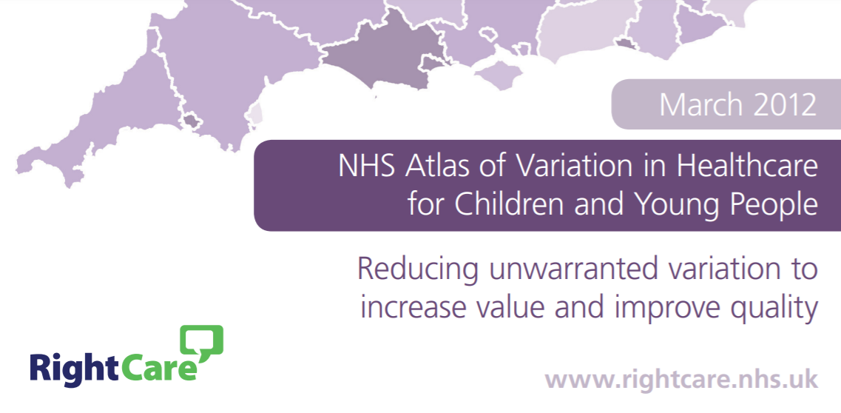

Slide 59

https://stateofchildhealth.rcpch.ac.uk/

Slide 60
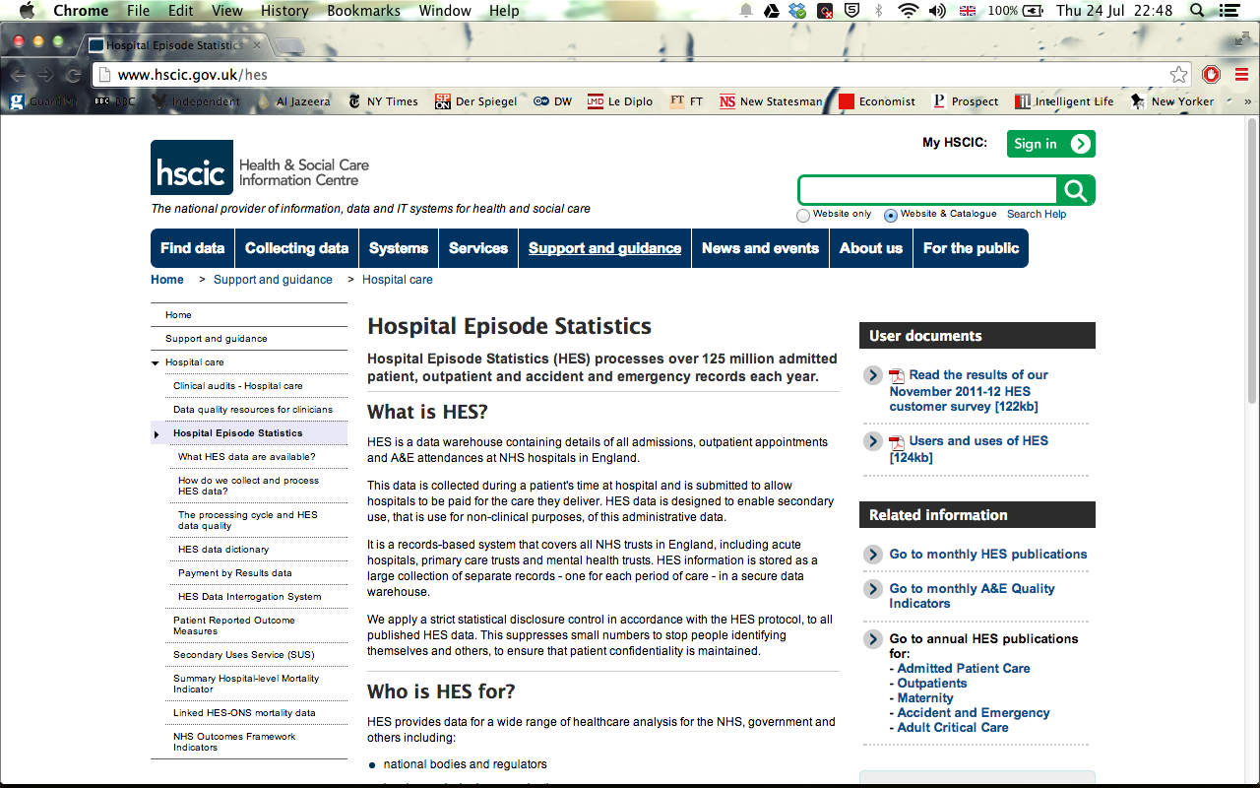
Notes:
http://www.hscic.gov.uk/hes
Electronic record of every inpatient or day case episode of patient care in every NHS (public) hospital
14 million records a year
300 fields of information including
Patient details such as age, sex, address
Diagnosis using ICD10
Procedures using OPCS4
Admission method
Discharge method
HES regarded as unreliable by many clinicians

Slide 61
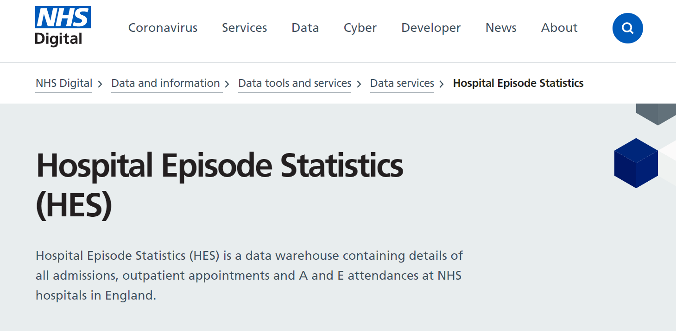
https://digital.nhs.uk/data-and-information/data-tools-and-services/data-services/hospital-episode-statistics

Slide 62
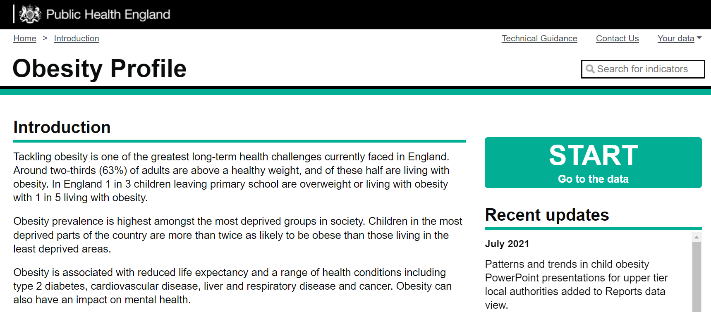
https://fingertips.phe.org.uk/profile/national-child-measurement-programme
Notes:
http://www.noo.org.uk/visualisation

Slide 63
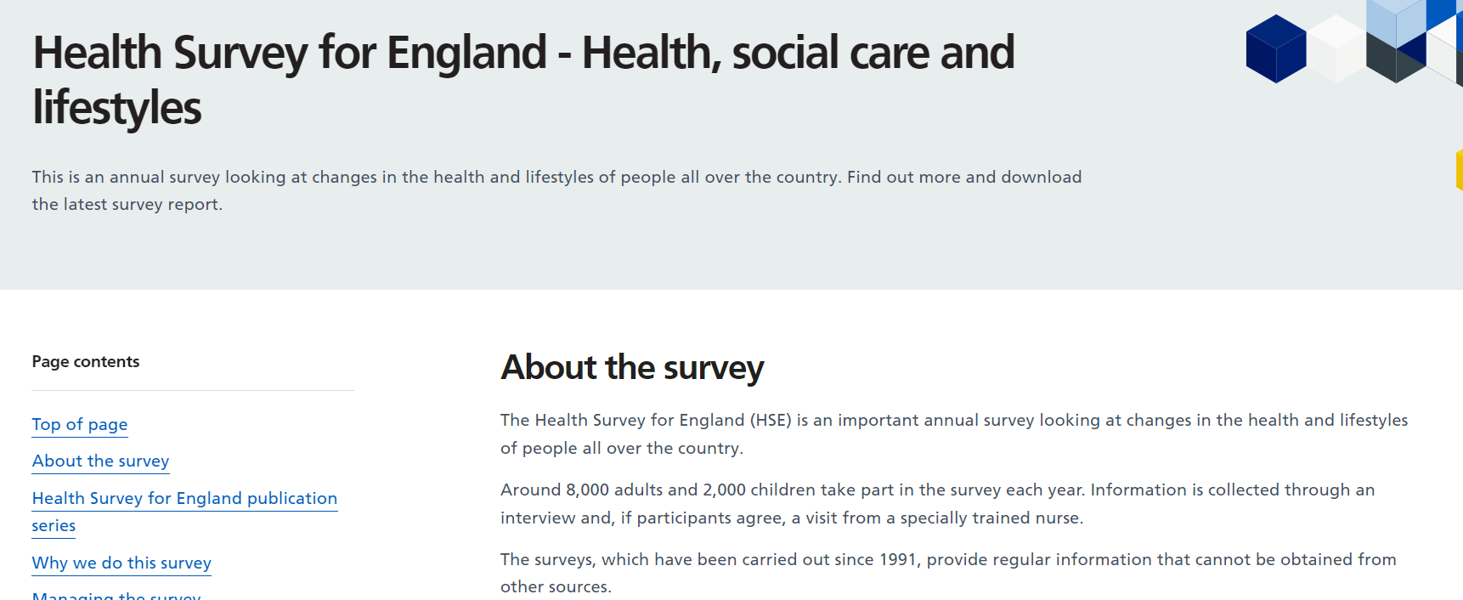
Notes:
http://data.gov.uk/dataset/health_survey_for_england

Slide 64
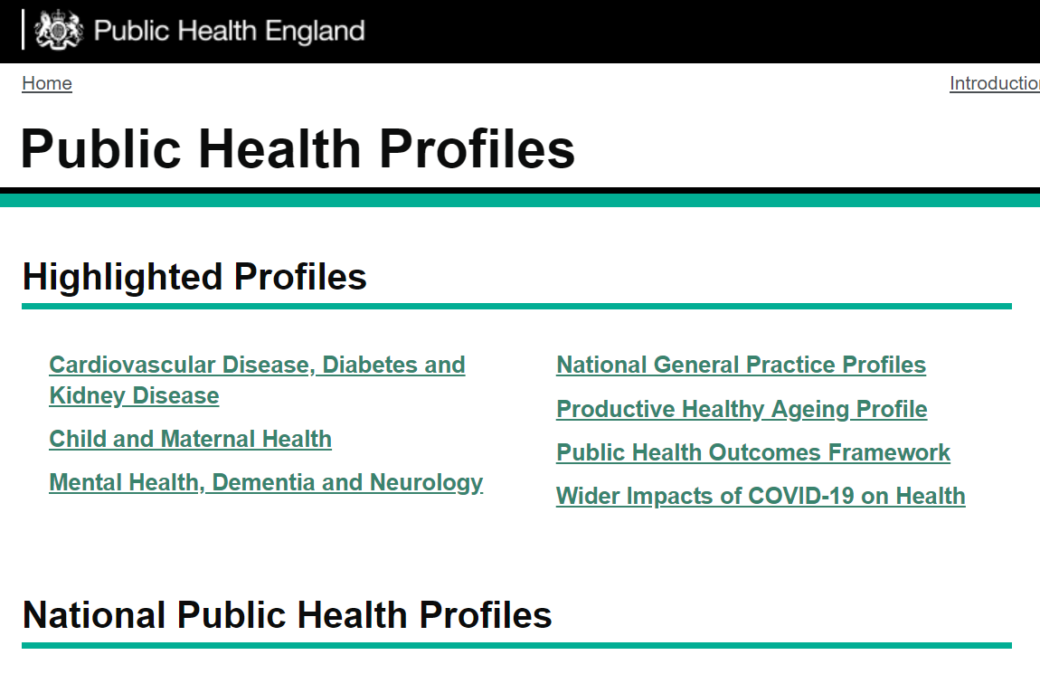
https://fingertips.phe.org.uk/

Slide 65
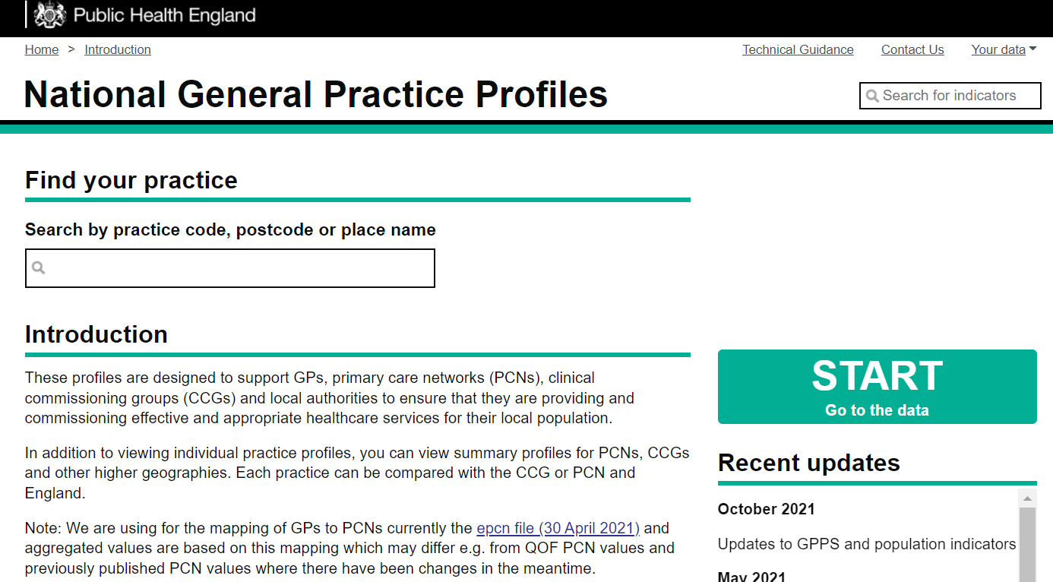

Slide 66
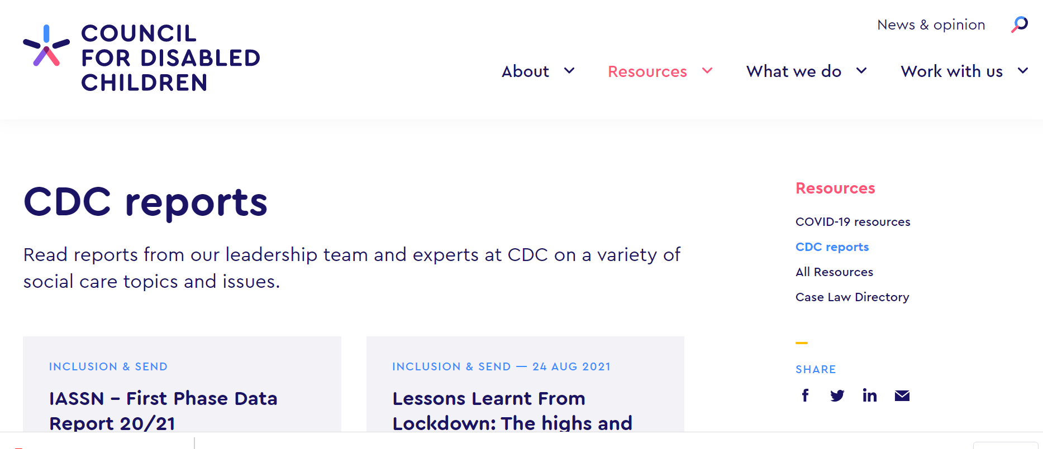

Slide 67
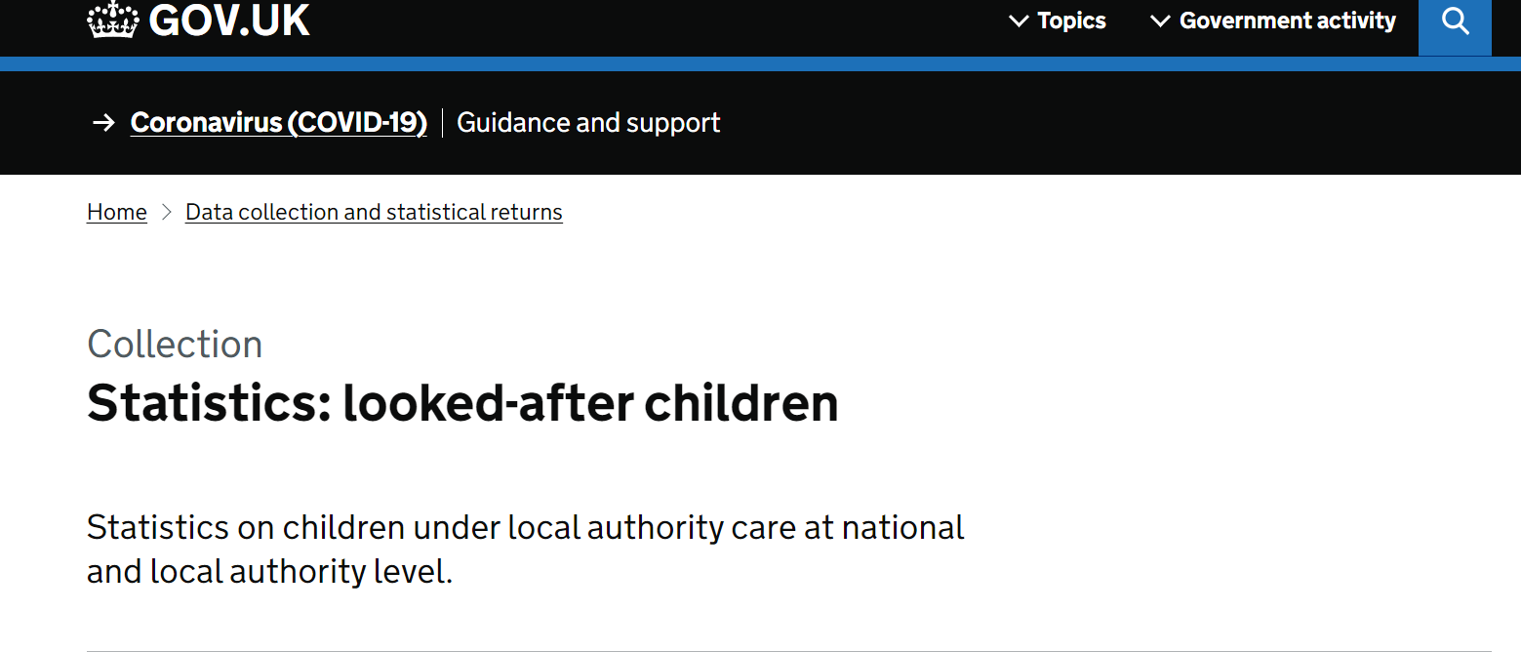

Slide 68
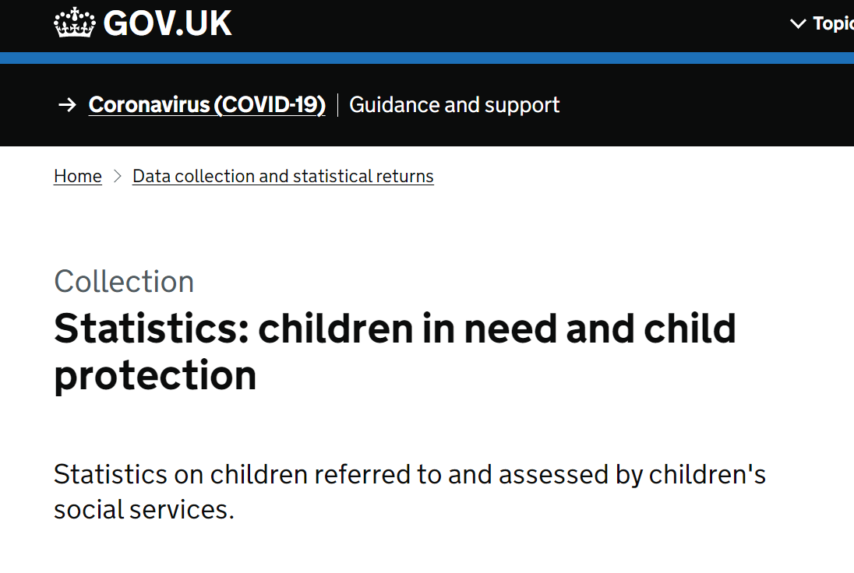

Slide 69
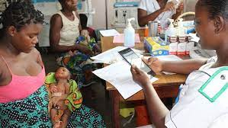


Learning health systems/ communities
https://youtu.be/hBBwTkC4SB4

Slide 70

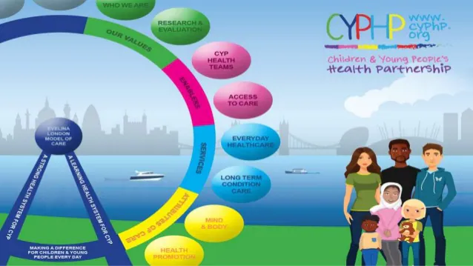
Children and young people’s health partnership

Slide 71
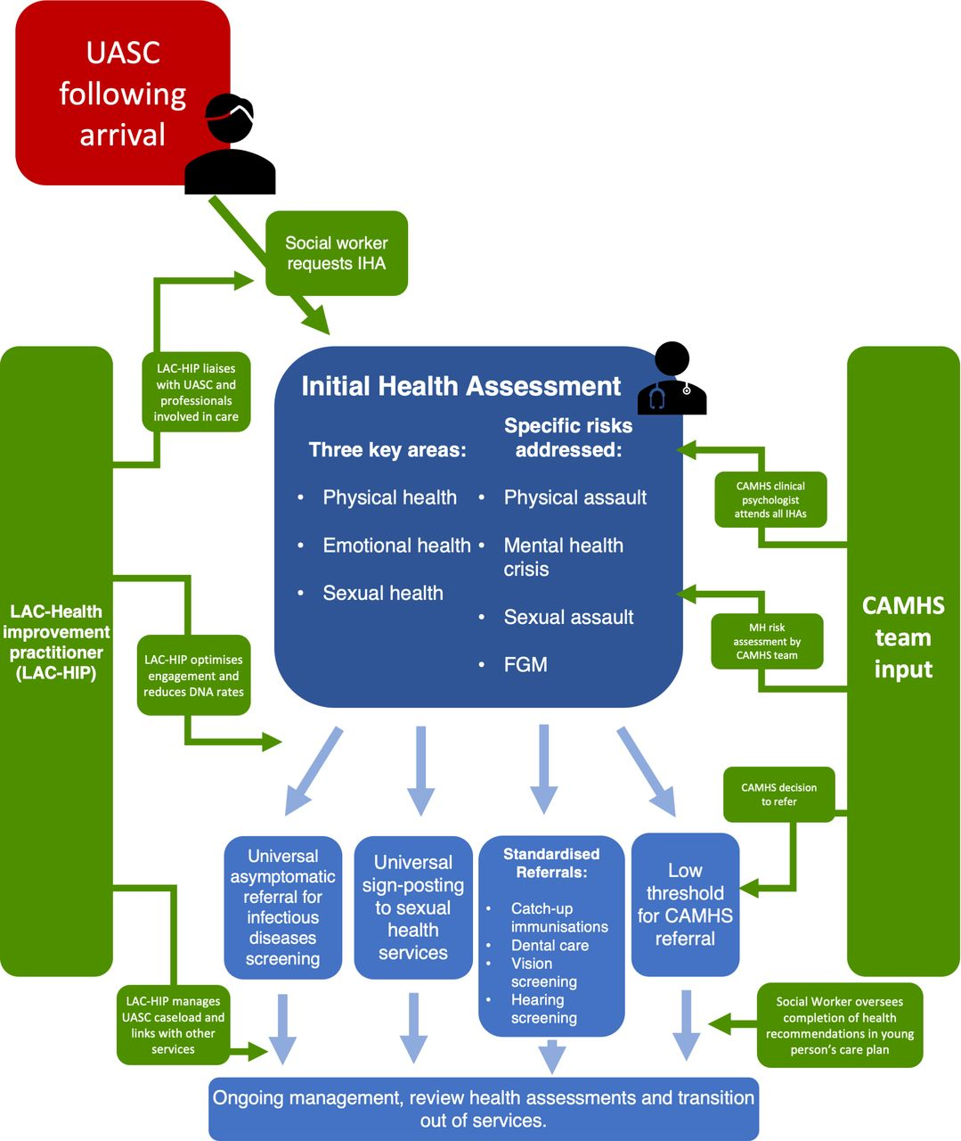

UASC integrated pathway
https://adc.bmj.com/content/early/2021/10/16/archdischild-2021-322319

